Slide 1

Personal Diary
_ Write your day _
By: Sadat, Anika, Farhan

Slide 2


What the project does:
Allows users to securely store diary entries
Supports adding, viewing, searching, editing, and deleting entries
Allows user to exporting all entries to a text file

Slide 3
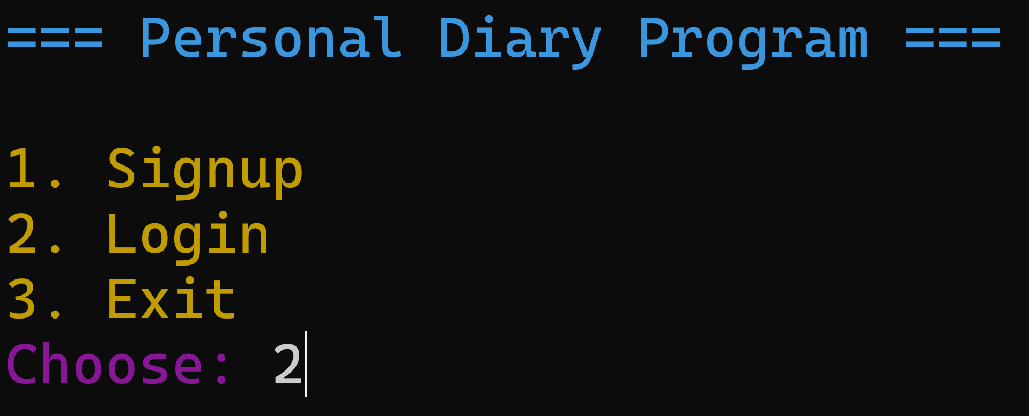

Your information, our responsibility.

Slide 4
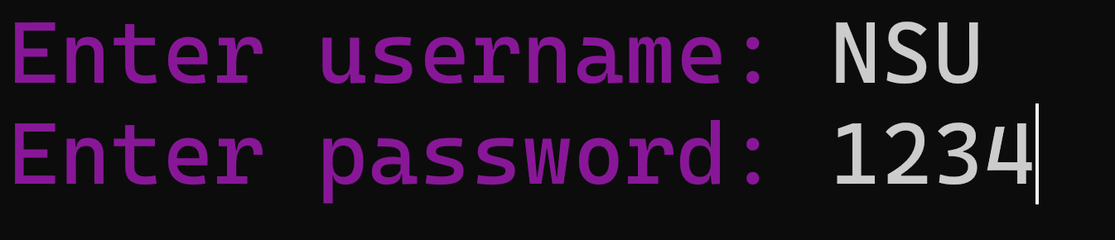

Sign-up and Log-in with
your name and a password.

Slide 5
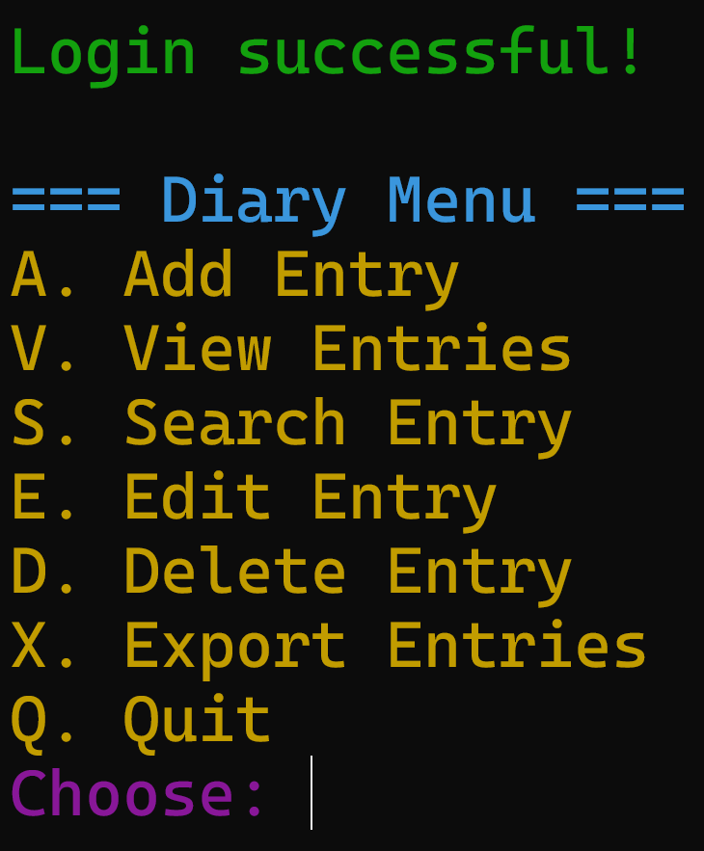

Key features that will provide users flexibility & enhance the usability.

Slide 6


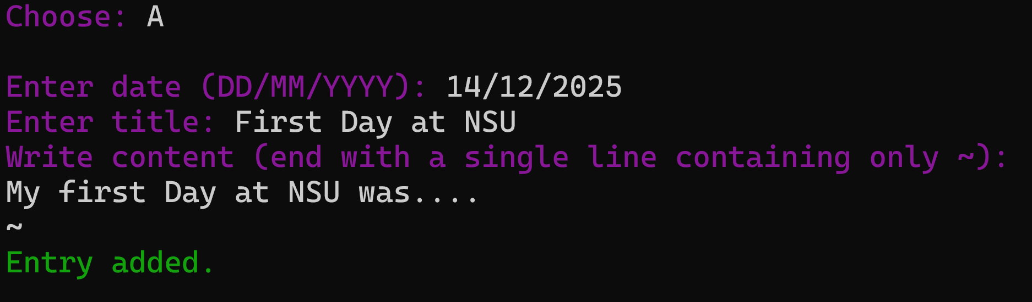
Journal your thoughts

Slide 7
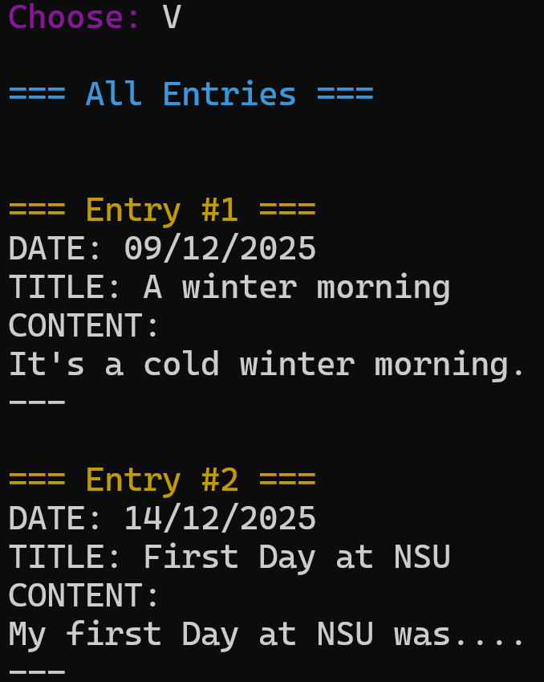


User can easily access and review all previous entries.

Slide 8

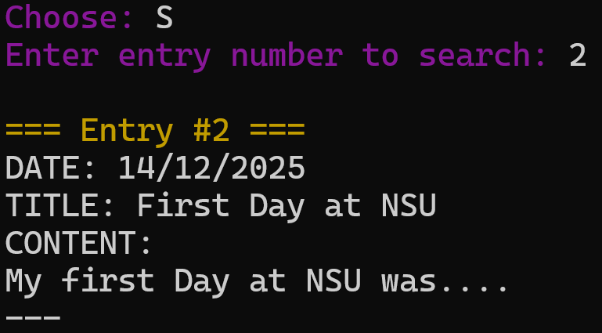

Search a particular diary entry easily.

Slide 9


Edit of Delete a particular entry.

Slide 10
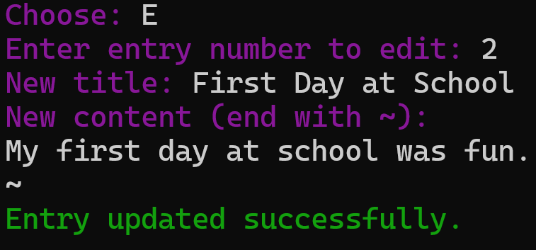
Edit an entry

Slide 11
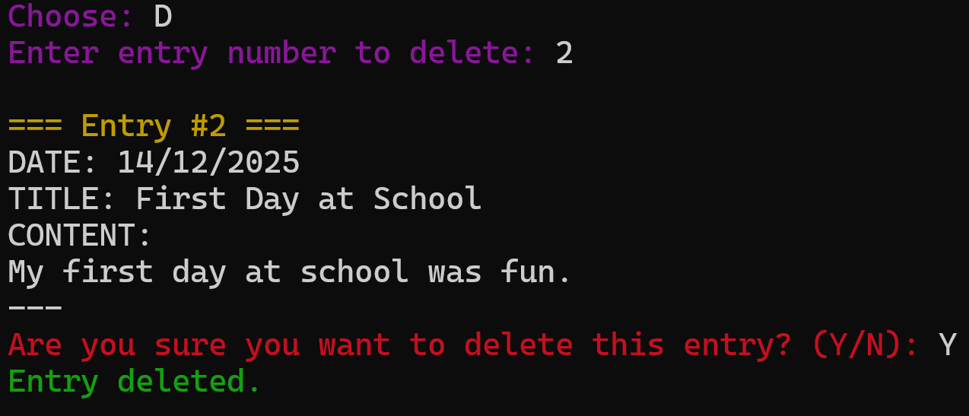
Delete a entry

Slide 12
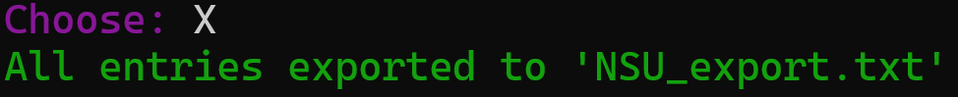
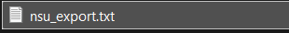

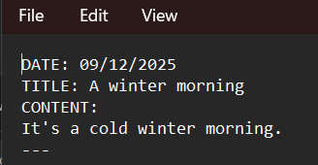
Export your diary entries to a Text file.

Slide 13
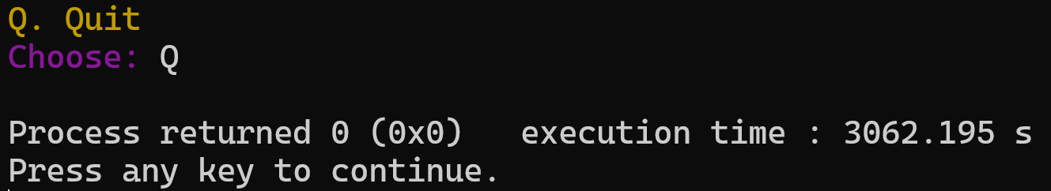

Quit when you are done.

Slide 14

Summary
Personal Diary System
Main Menu Add, View, Search, Edit, Delete and Export Entries.
Secure Login System

Slide 15

Thank You

